Slide 1
MONSTA CREATION!
Art Lesson - Fall 2020

Slide 2
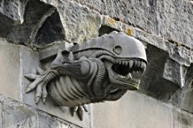
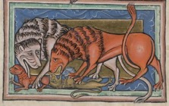
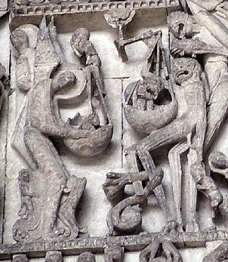
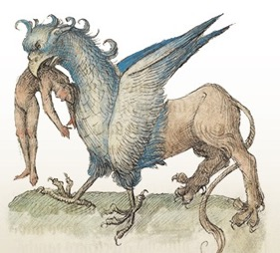
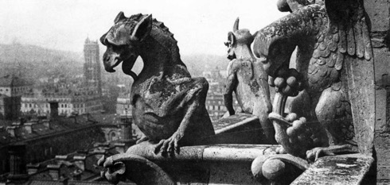
Brief History
The concepts of monsters existed all the way back.
In the Medieval Ages, Monsters art are to remind people to be good people so they would end up going to hell.

Slide 3
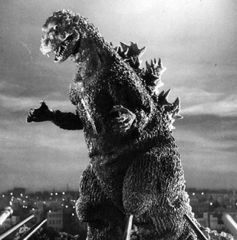
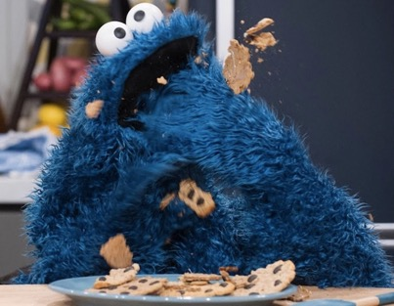
Modern Times
Nowadays, especially in Entertainment, Monsters transforms into a variety of things. Some are still scary, but others are cute and funny.

Slide 4
Character Design
To make a believable Monster or any character, artists need start with a character design.
This helps lay out the characters’ looks and personalities
Shapes, lines, and color all helps to formulate that

Slide 5
Examples - Pixar

Slide 6
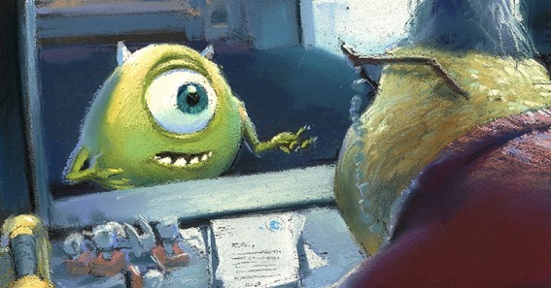
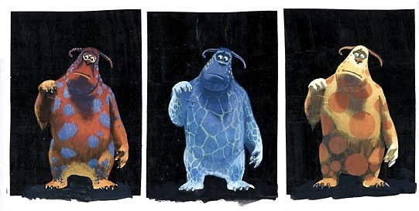

Slide 7
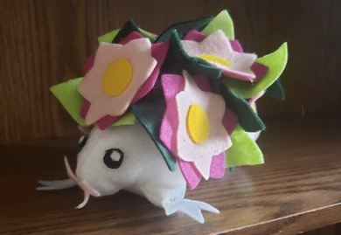
Assignment
PT 1: Character Design
You will be making a front view, profile view, & bottom view/three-quarters view of your character.
Character will be in color.
PT 2: Plushie
You will be making a plushie based on the character design that you have created.

Slide 8
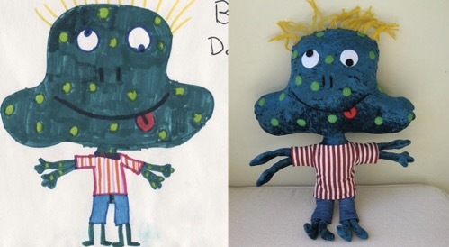
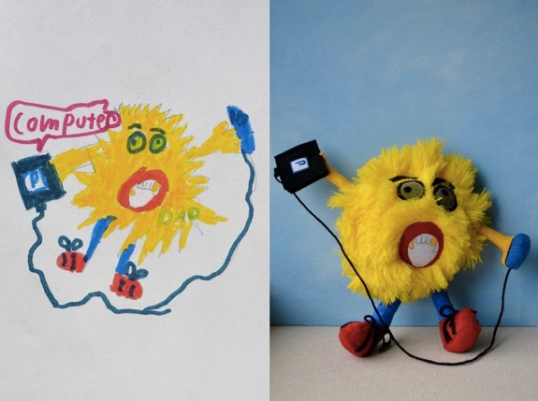
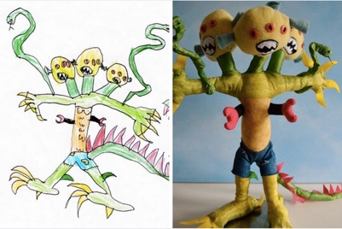
Wendy Tsao

