Slide 1
Shrines
A short introduction and history

Slide 2
What is a Shrine?
A shrine is a holy or sacred site dedicated to a specific god, ancestor, hero, or similar figure of respect.
Often considered a place of worship.
Shrines contain idols, relics, or other such objects associated with the figure being venerated.

Slide 3
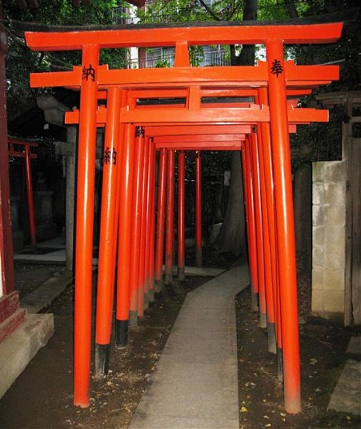
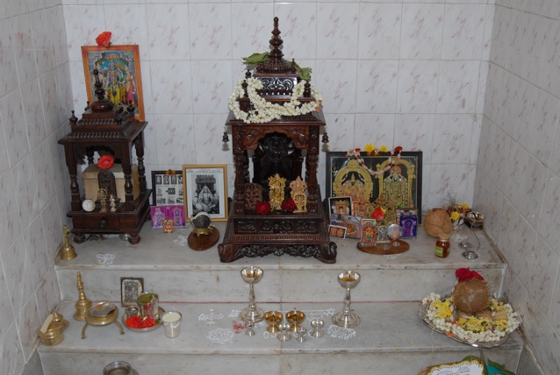
Shrines Around the World
Mexico: Dia De los Muertos
India: Pooja Room
Tokyo: Inari

Slide 4
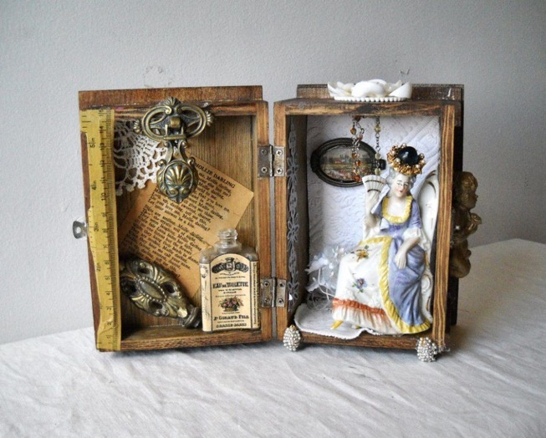
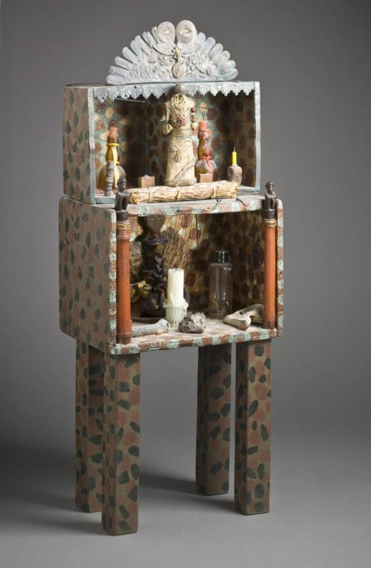
Shrine & Assemblage
Assemblage: a collection or gathering of things or people.

Slide 5
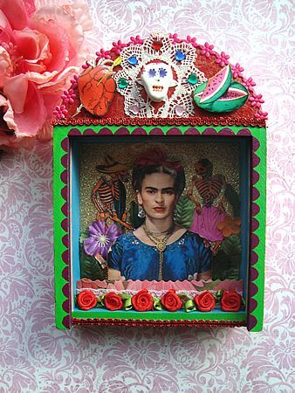
Home Made Shrines

Slide 6
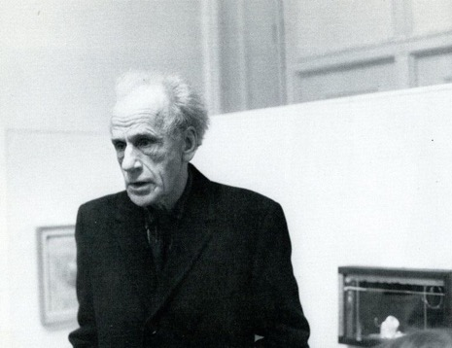
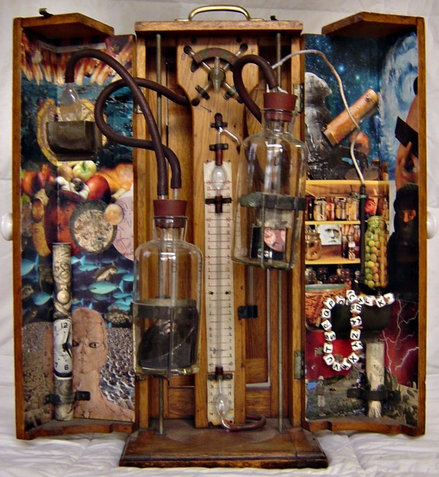
Assemblage Artist: Joseph Cornell
Joseph Cornell (December 24, 1903 — December 29, 1972) was an American artist and film maker, one of the pioneers and most celebrated exponents of assemblage.
https://milenaolesinska77.medium.com/joseph-cornell-pioneer-of-assemblage-art-87d7fa3c06c4

Slide 7
Discussion:
Why do you think Shrines exist?
What kind of Shrine do you want to make?
Who would you make a shrine for and why?
How would you honor this person in your shrine?

Slide 8
Questions

