Slide 1
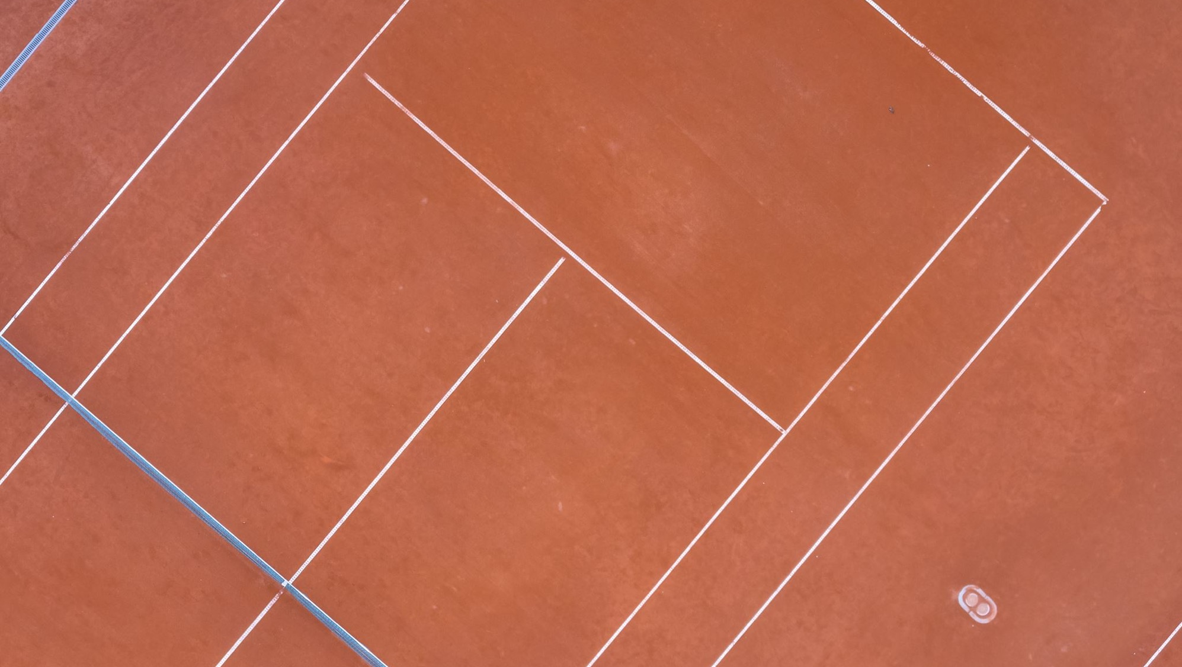
“Here, have some clay”
Ceramics 2

Slide 2
Day 1
What comes to mind when you hear the word “ceramics”?

Slide 3
Day 1
How can we elevate clay beyond:
Commodity
Canvas
Form

Slide 4
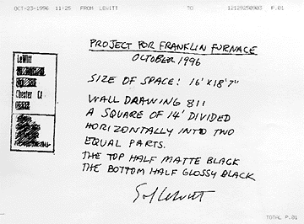
Inspiration from Conceptual art
Sol Lewitt: Wall Drawing 811
René Magritte, The Treachery of Images

Slide 5
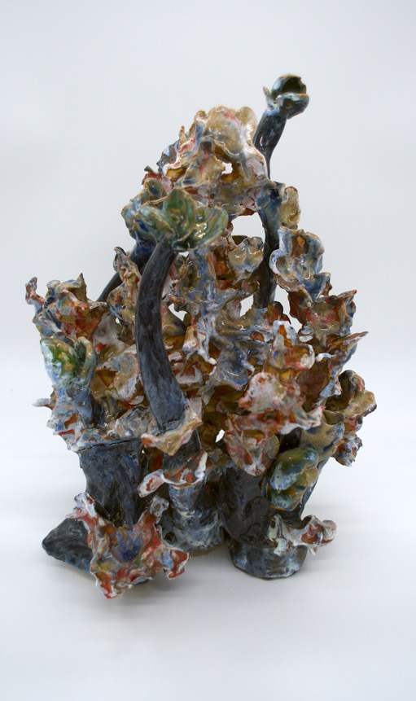
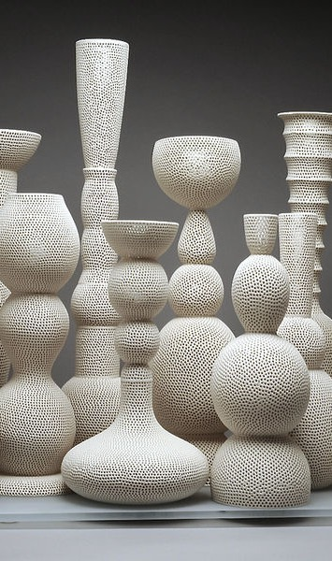
How can this apply to ceramics?
Tony Marsh, Perforated Totem
Jeffrey Frame, Organism-ism

Slide 6
Studio Time
Simply play with the clay today:
Find one thing about the clay that fascinates you.

Slide 7
What did you discover today?

Slide 8
Homework
Write a journal entry in your sketchbook:
What did you find fascinating about clay? Why?
Write in enough detail so I’ll know what. You’re talking about.

Slide 9
Days 2 & 3: Studio days
Complete 3 different examples of the argument you developed for day 1’s homework.

Slide 10
Day 4: Critique
Present your creations:
Tell us what you find fascinating about clay, why you find it fascinating, and how your creations support your fascination.
Provide feedback:
Give your peers CONSTRUCTIVE insights if you feel that there are holes in their argument’s logic. ASK THEM QUESTIONS!

Slide 11
Self-Reflection
Write an entry in your sketchbook:
Consider the criticisms you received today, what could you do to mitigate these arguments against your work? How can you adjust a future creation to account for these criticisms?

