Slide 1
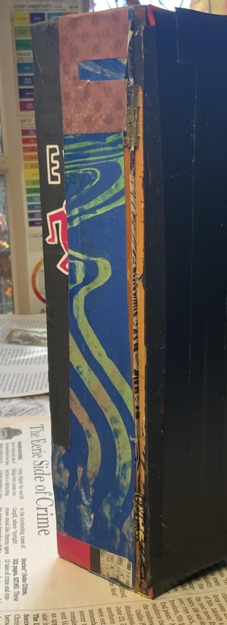
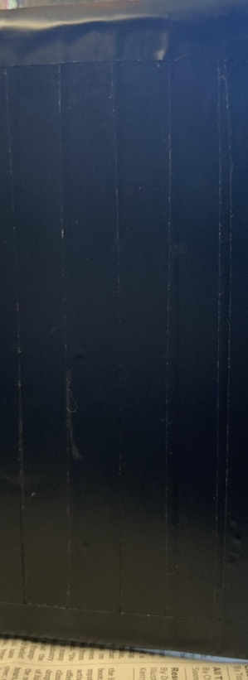
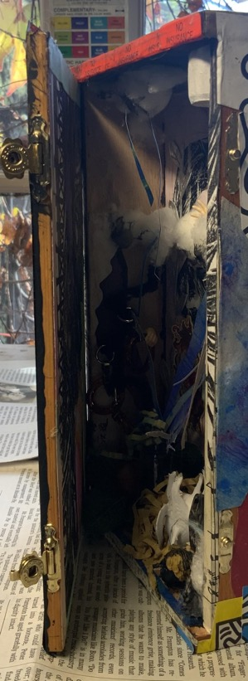
DreamBox:
Growth
Mindset
Mr.Amadeuz • December 15/2020

Slide 2
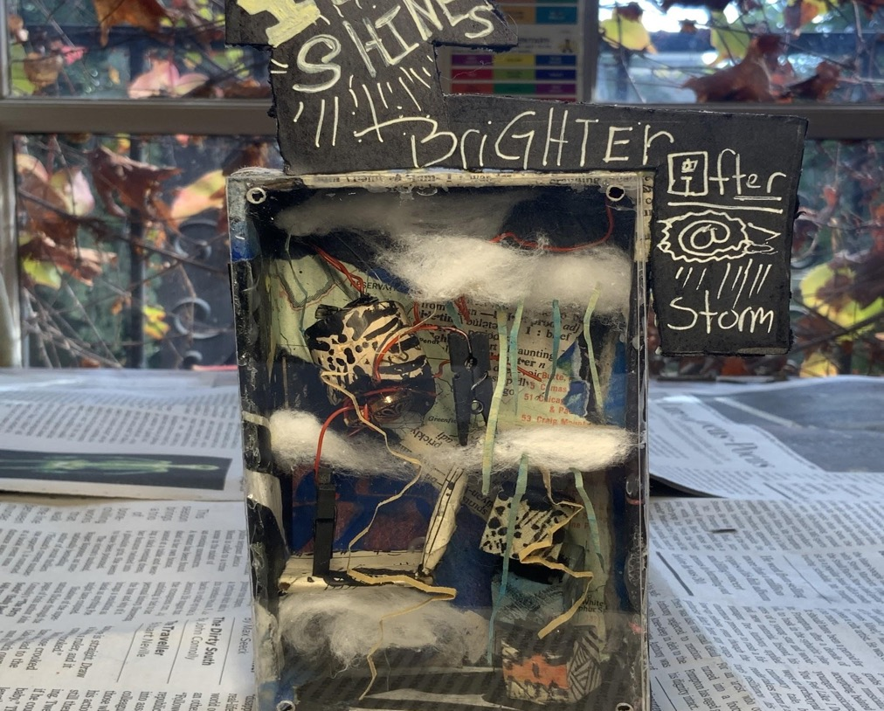
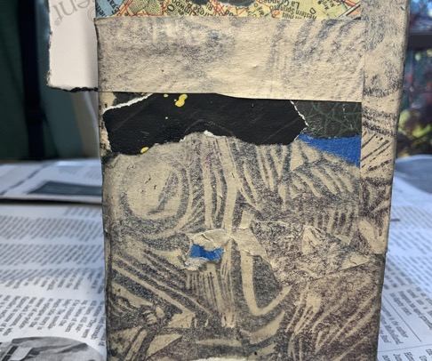
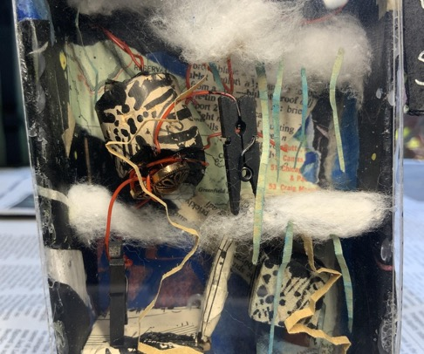
Small Shrine
Anticipatory set: Small Shrine
An introduction to growth mindset and setting goals.
Critical thinking towards one’s voice within literature
Intro to a more complex project

Slide 3
My Dreams or goals?

Slide 4
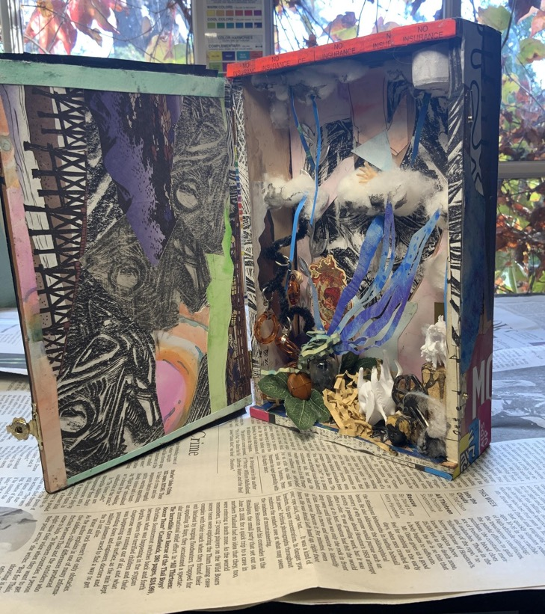
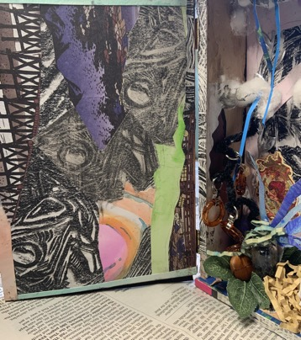
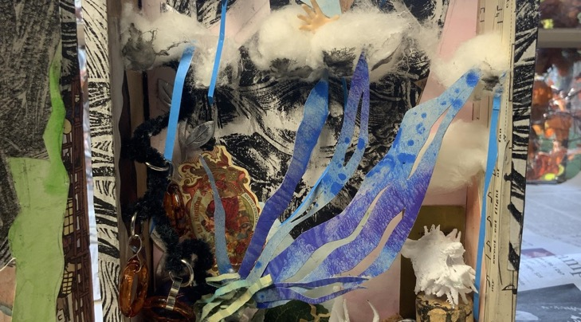
Breakdown of what I used:Scrap test prints, paste paper, cotton balls, misc .paper

Slide 5
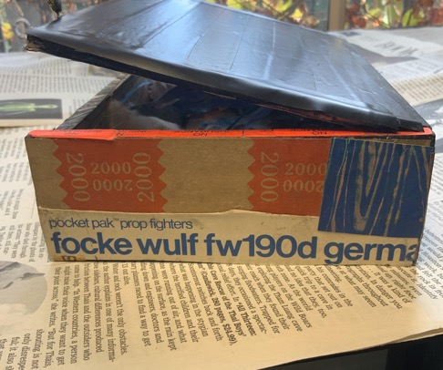
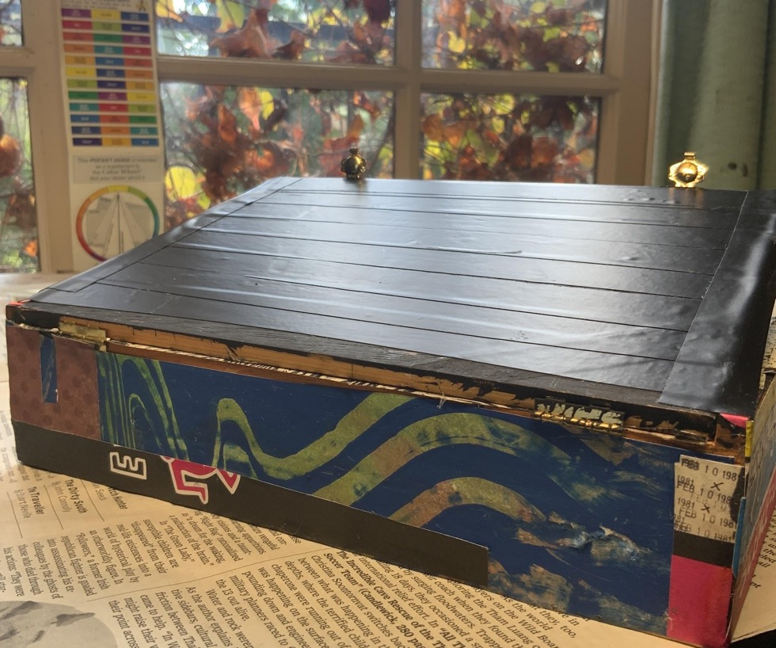
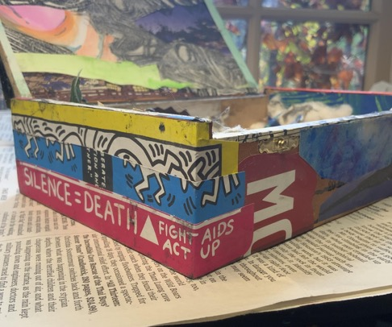

Slide 6
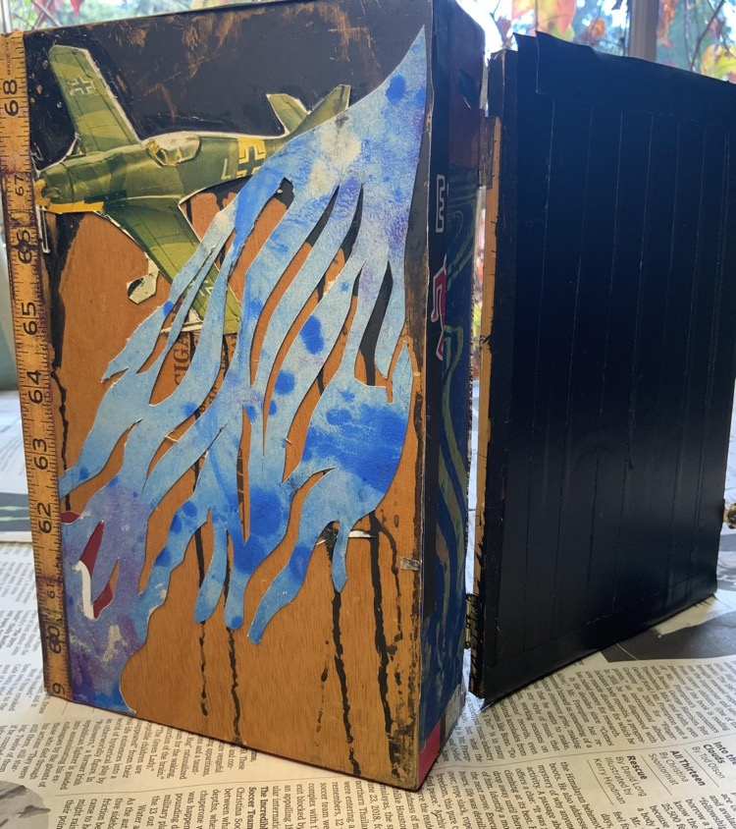
Whats does it mean?
as·sem·blage
/əˈsemblij/
noun
a collection or gathering of things or people. "a wondrous assemblage of noble knights, cruel temptresses, and impossible loves"
Similar:
collection
accumulation
Conglomeration
Definitions from Oxford Languages

Slide 7
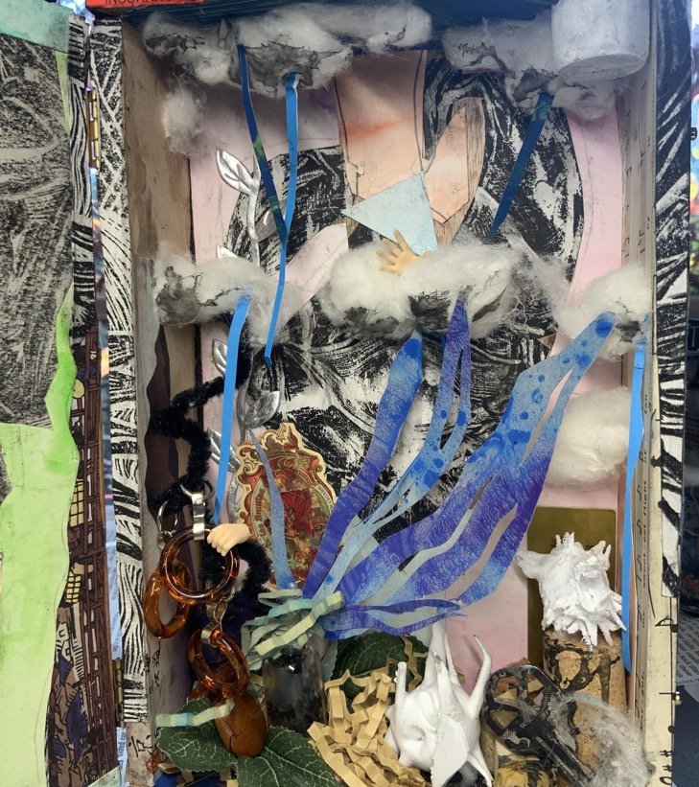
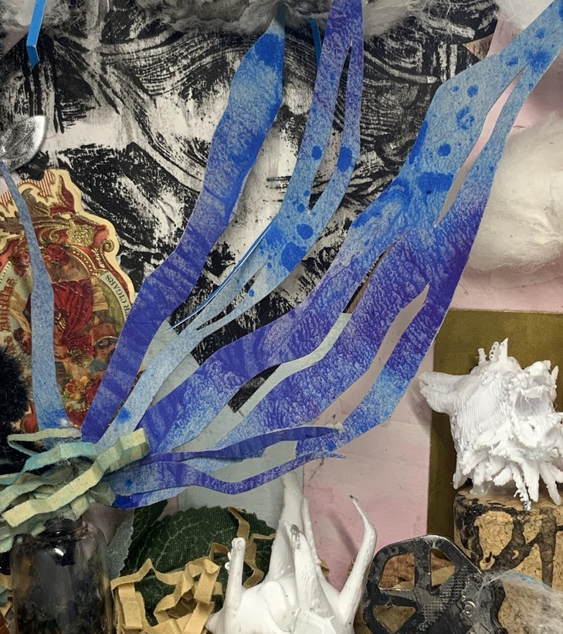

Slide 8
Artists to talk about

Slide 9
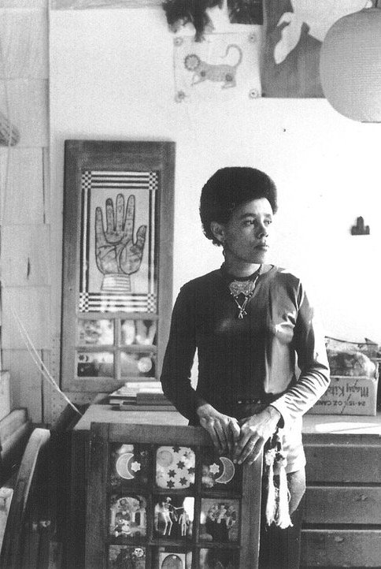
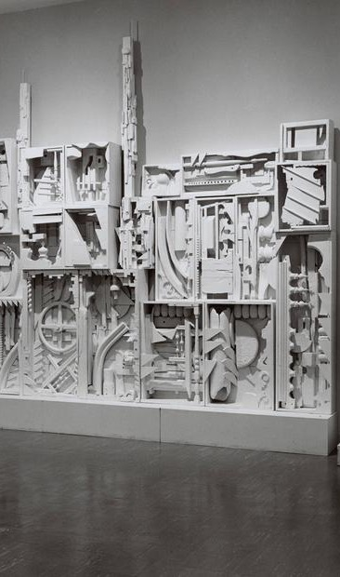
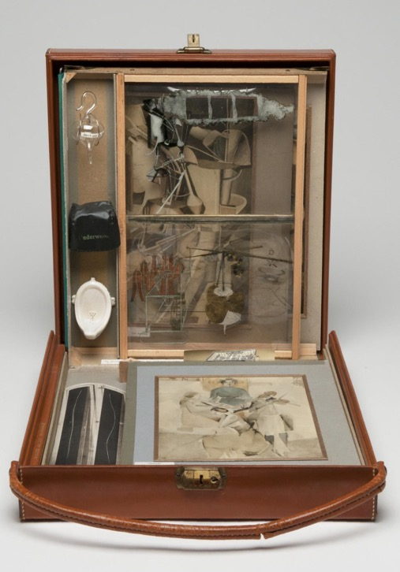
Betye Saar
Louise Nevelson
Marcel Duchamp

Slide 10
lesson plan for dreambox

