Slide 1
Paper Mache House Project

Slide 2
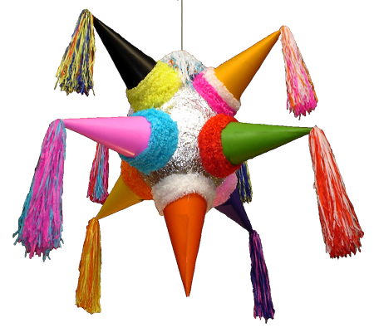
Paper mache was brought to Mexico by the Spaniards and introduced to the native population by the Jesuits. In the past, paper mache crafters in Mexico were called cartoneros and they worked in the traditional markets selling: Piñatas used during Christmas season and birthday parties.

Slide 3
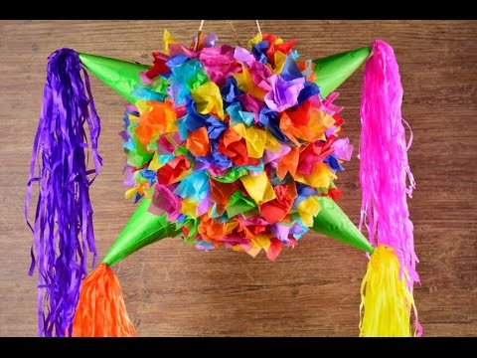

Slide 4
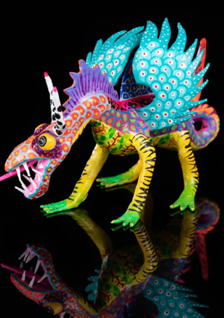
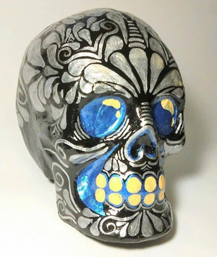
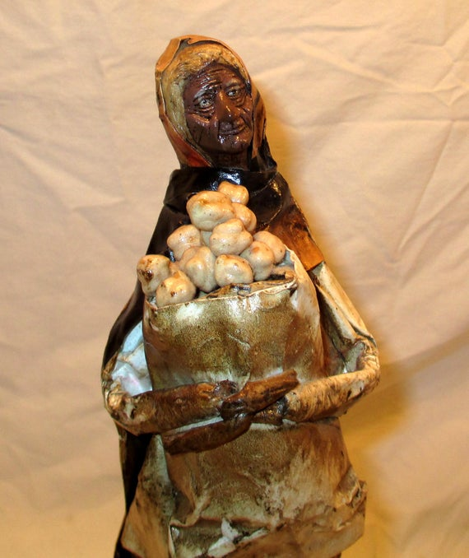
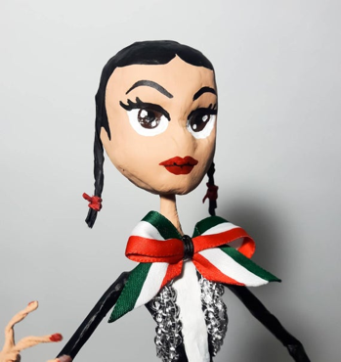
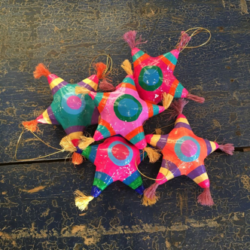

Slide 5
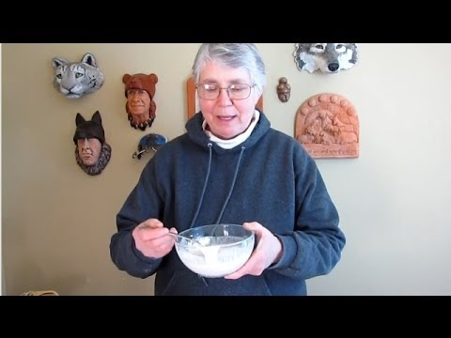

Slide 6
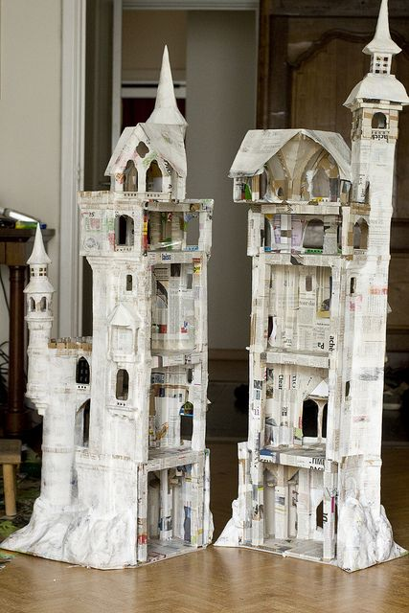
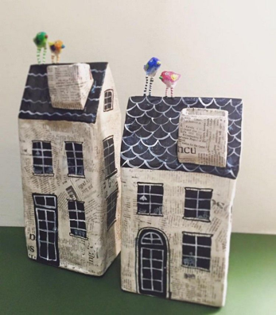
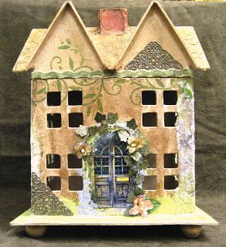
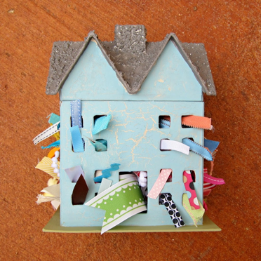
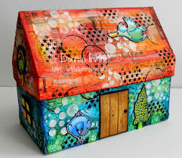

Slide 7
Make your own!

Slide 8
Work Cited
https://carapan.com.mx/collections/alebrijes/products/paper-mache-alebrije-mexican-hand-crafted-dragon-medium-size
https://www.etsy.com/hk-en/listing/548235900/vintage-paper-mache-figurine-folk-art
https://www.pinterest.ca/pin/335658978476612765/
https://www.etsy.com/dk-en/listing/570960983/traditional-skull-paper-mache-mexican
https://www.pinterest.com/pin/570479477772619002/
https://www.pinterest.com/pin/528961918706624683/
https://www.awesomeinventions.com/quirky-paper-mache-houses/

