Slide 1
PRESSING ISSUES
USING RELIEF PRINTMAKING TO ADDRESS A SOCIAL ISSUE

Slide 2
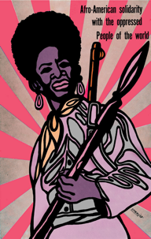
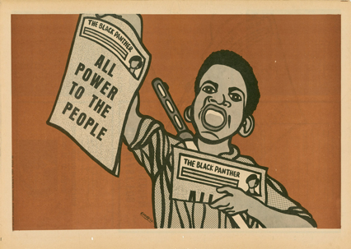
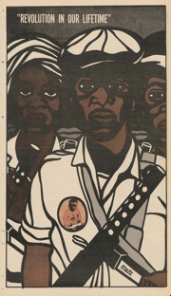
Social Activist Artists
Emory Douglas
An influential force within the Black Panther Party from 1967 to 1980
Depicted African Americans as revolutionary fighters, instead of victims

Slide 3
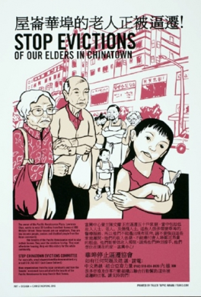
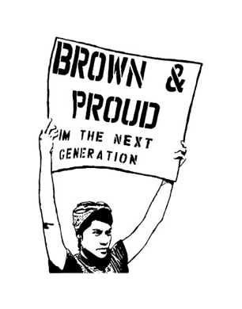
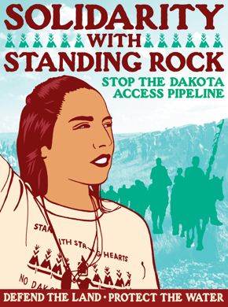
Social Activist Artists
Melanie Cervantes
Creates visual art that is inspired by the people around her and her communities’ desire for radical social transformation
Her work inspires curiosity, raises consciousness and inspires solidarities among communities of struggle.

Slide 4
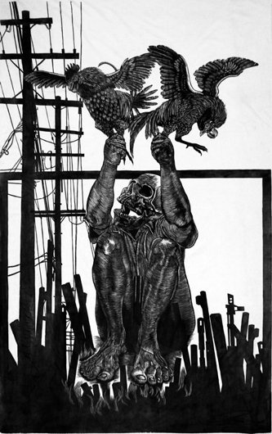
Social Activist Artists
Abel Alejandre
Explores the concept of masculinity/manhood in his work.
Often uses of the rooster as a metaphor and symbol for manhood, valor, machismo, and patriarchy. Similarly, some men embody this quality, this sense of cunning, this unique nature, making them ideal subjects of inquiry.
Tale of Two Birds, 2012 woodblock print, ink on muslin

Slide 5
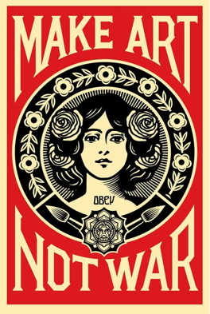
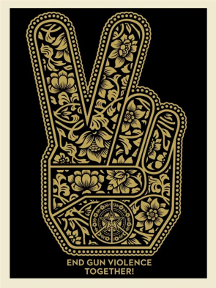
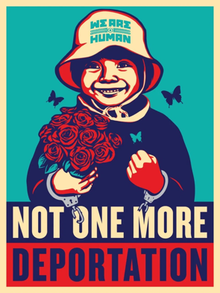
Social Activist Artists
Shepard Fairey
Address topics such as war, politics, gun violence and civil rights in his work

Slide 6
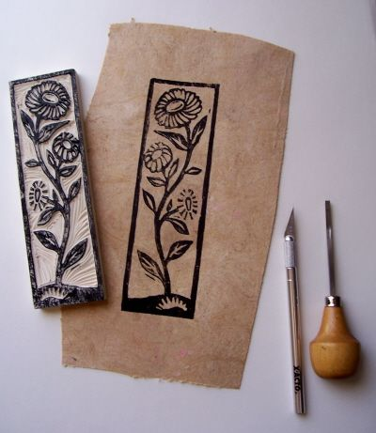
What is relief printmaking?
relief printmaking:
a process that consists of cutting away the printing surface in such a way that all that remains of the original surface in the design are printed.

Slide 7
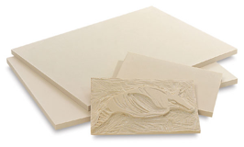
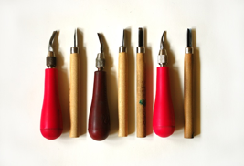
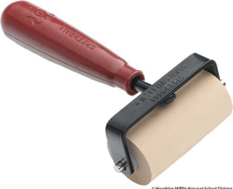
Relief Printmaking Materials
Relief printing blocks- made from flat sheets of material such as wood, linoleum, metal, styrofoam etc.
Cutting tools - used to cut away the areas from block that will not print
Brayer (aka roller) - used to spread ink onto the block

Slide 8
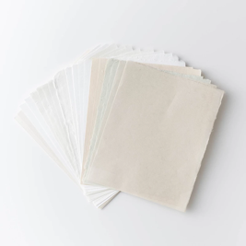
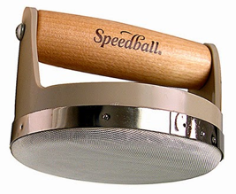
Relief Printmaking Materials (continued)
Paper - paper is placed on top of the block and the image is transferred by rubbing with a hand, spoon or baren.
Baren - used to help evenly transfer image from block to paper

Slide 9
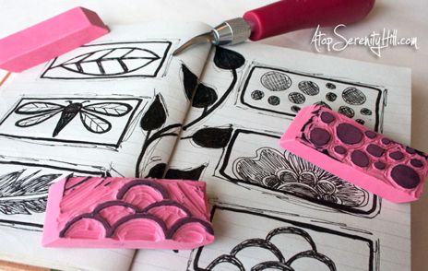
Anticipatory Set
To introduce students to printmaking I will give students an eraser, cutting tools, paper, and printing ink to create a stamp essentially.
Students will learn how negative and positive space works and whatever is removed from the block will not print on the paper.
Keep in mind the print is a mirror image of the original block. So if they want to use text in their block, they have to flip the text so it prints correctly. This will be helpful for students to understand when working on the final project.
Notes:
A simple example of relief printing is a rubber stamp pressed into a stamp pad and pressed onto a piece of paper.

Slide 10
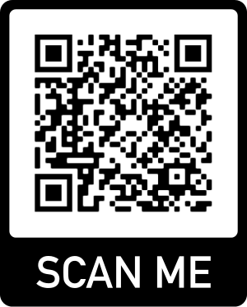
What are we going to print?
Create a print where you:
Address a social issue
you find in your community
Examples: crime, gentrification, homelessness
Address a global issue
Examples:
global warming, civil rights, war
OR

